Slide 1





a platform that connects researchers, innovators, entrepreneurs and investors who are interested in transforming scientific and
technological outcomes into new products and services that benefit society.
Start

Slide 2

Supervisors
Dr. Mohamed Zedan
Lecturer, Department of Information Technology at Egyptian E-Learning University (EELU)
Eng. Abd-Alrahman Mahmoud
Teacher Assistant, Department of Information Technology at Egyptian E-Learning University (EELU)

Slide 3
Team Members
Mohamed Omar
Safwat Ahmed
Ahmed Mahmoud
19-01219
20-00141
20-01226
Islam Sayed
Mohamed Maher
Menna-Allah Hassan
20-02051
20-02048
20-01914

Slide 4

Abstract
Technohope, a platform that connects researchers, innovators, entrepreneurs and investors who are interested in transforming scientific and technological outcomes into new products and services that benefit society.
We will take a look at the concept and importance of technology transfer, the features and benefits of Technohope, the process and examples of technology transfer projects facilitated by Technohope and the steps to join and use Technohope.

Slide 5

Outline
Introduction
Problem Statement
Problem Solution
Related Works
Research Objectives
Development Methodology
How It Works
Platform Objectives
Platform Requirements
Technology Stack
Time Plan
Current Progress
Challenges
Conclusion
Future Work
References

Slide 6

Introduction
● Technology transfer is the dissemination of knowledge and intellectual property from the creators to the users of technology, with the aim of creating and diffusing new technologies that can solve global challenges and improve the quality of life of people.
● Technology transfer is a key driver of economic and social development, as it enables the creation of new industries, markets, jobs and revenues, as well as the enhancement of existing ones.
● Technology transfer also contributes to the advancement of science and innovation, as it fosters a culture of collaboration and learning among the stakeholders of the innovation ecosystem, such as researchers, innovators, entrepreneurs and investors.

Slide 7


Problem
Statement
However,
technology transfer is often
hindered by various barriers, such as:
● Lack of awareness:
Many researchers and innovators are not
aware of the potential and value of their
technologies and patents, or the
opportunities and resources available for
technology transfer.
● Lack of access:
Many entrepreneurs and investors are not able to access the technologies and patents that match their interests, needs, or goals, or to contact the owners of the technologies and patents.

Slide 8

● Lack of awareness:
Many researchers and innovators are not
aware of the potential and value of their
technologies and patents, or the
opportunities and resources available for
technology transfer.
Problem
Statement
However,
technology transfer is often
hindered by various barriers, such as:
● Lack of access:
Many entrepreneurs and investors are not able to access the technologies and patents that match their interests, needs, or goals, or to contact the owners of the technologies and patents.
● Lack of funding:
Many technology transfer projects require significant financial resources to cover the costs of development, testing, prototyping, licensing, marketing and scaling.

Slide 9

● Lack of access:
Many entrepreneurs and investors are not able to access the technologies and patents that match their interests, needs, or goals, or to contact the owners of the technologies and patents.
Problem
Statement
However,
technology transfer is often
hindered by various barriers, such as:
● Lack of funding:
Many technology transfer projects require significant financial resources to cover the costs of development, testing, prototyping, licensing, marketing and scaling.
● Lack of incentives:
Many parties involved in technology transfer lack the motivation and recognition to engage in technology transfer, due to the risks, uncertainties and complexities involved.

Slide 10
● Lack of funding:
Many technology transfer projects require significant financial resources to cover the costs of development, testing, prototyping, licensing, marketing and scaling.
Problem
Statement
However,
technology transfer is often
hindered by various barriers, such as:
● Lack of incentives:
Many parties involved in technology transfer lack the motivation and recognition to engage in technology transfer, due to the risks, uncertainties and complexities involved.

Slide 11

Technohope provides a
user-friendly, platform that
offers the following
features and benefits:
Problem
Solutions
To address these barriers, we propose Technohope, a platform that connects researchers, innovators, entrepreneurs and investors who are interested in transforming scientific and technological outcomes into new products and services that benefit society.
● A database of technologies and patents that are available for licensing or collaboration.
● A marketplace of opportunities and resources, such as funding, grants, competitions, events, or training programs, that can support the technology transfer process.
● A community of peers and partners who can share their experiences, insights and best practices on technology transfer.

Slide 12


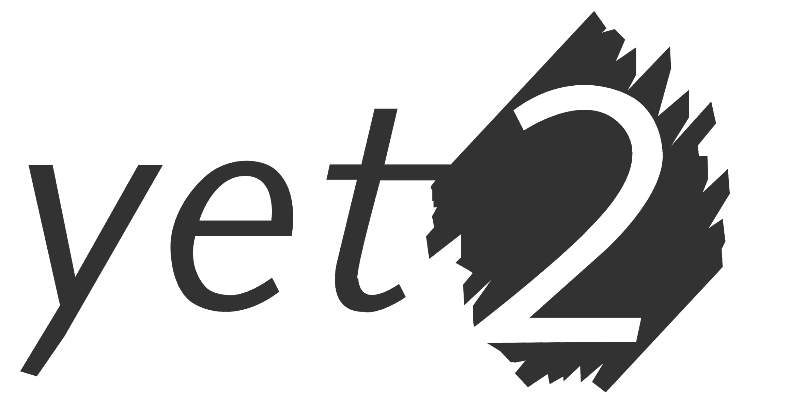

Related Works
Other Technology transfer platform
innoget
yet2
refseek

Slide 13


Research Objectives
Design and develop a platform that connects researchers, innovators, entrepreneurs and
investors who are interested in transforming scientific and technological outcomes into new
products and services that benefit society.

Slide 14
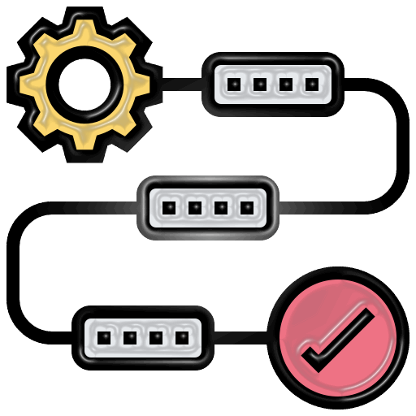
Development methodology
Literature review
Users research
Platform design
Platform development
Platform testing
Platform evaluation

Slide 15

How it works
● Researchers and innovators can register on the platform and upload their technologies and patents, along with relevant information, such as description, features, advantages, applications, stage of development, intellectual property status and licensing terms.
● Entrepreneurs and investors can browse the platform and discover technologies and patents that match their interests, needs, or goals, They can also contact the owners of the technologies and patents to express their interest, ask questions or request more information.
● Technohope facilitates the communication and negotiation between the parties and provides tools and templates for drafting and signing agreements, such as non-disclosure agreements, licensing agreements or collaboration agreements.

Slide 16
How it works
Example
● Researchers and innovators can register on the platform and upload their technologies and patents, along with relevant information, such as description, features, advantages, applications, stage of development, intellectual property status and licensing terms.
● Entrepreneurs and investors can browse the platform and discover technologies and patents that match their interests, needs, or goals, They can also contact the owners of the technologies and patents to express their interest, ask questions or request more information.
● Technohope facilitates the communication and negotiation between the parties and provides tools and templates for drafting and signing agreements, such as non-disclosure agreements, licensing agreements or collaboration agreements.
● A researcher from a university in Egypt developed a novel nanomaterial that can purify water from heavy metals and organic pollutants.
● He uploaded his patent on Technohope and was contacted by an entrepreneur from a social enterprise in Kenya, who was looking for a low-cost and sustainable solution for providing clean water to rural communities.
● They agreed to license the patent and collaborate on developing and testing a prototype of a water filter based on the nanomaterial.
● They also received funding and mentorship from a grant program and an expert on water technologies that they found on Technohope.

Slide 17

Objectives
● Facilitate collaboration:
o Facilitating cooperation between researchers and investors.
● Enhancing research and discovery:
o Facilitate access to research requested by investors by providing certain features on the platform.
● Innovation support:
o Promoting innovation by paying attention to new and important research by presenting it and highlighting it through the platform.
● Ensuring the efficiency of researchers:
o Ensuring the efficiency of those searching for the method of submitting accreditations on the platform, for example, the employer or certificates.
● Encouraging cooperation between researchers:
o Encouraging cooperation between researchers in various fields.
● User evaluation and reporting:
o Establish an evaluation for the user and prepare a method to evaluate them in terms of participation.
● Customizable user profiles:
o Allow users to create detailed profiles showcasing their expertise, interests and technology.

Slide 18

Requirements
● Registration and login:
o The users should be able to register and login to the platform with their email and password.
● Profile creation and editing:
o The users should be able to create and edit their profiles with their personal and professional information.
● Technology and patent uploading and editing:
o The researchers and innovators should be able to upload and edit their technologies and patents, along with relevant information, such as description, features, advantages, applications, stage of development, intellectual property status and licensing terms.
● Technology and patent browsing and searching:
o The entrepreneurs and investors should be able to browse and search the technologies and patents that are available for licensing or collaboration, by keywords, categories, or filters.
● Technology and patent contacting and negotiating:
o The entrepreneurs and investors should be able to contact the owners of the technologies and patents that they are interested in and to negotiate the terms and conditions of the technology transfer agreements, such as non-disclosure agreements, licensing agreements, or collaboration agreements.

Slide 19
Requirements
● Registration and login:
o The users should be able to register and login to the platform with their email and password.
Non-functional requirements: The platform should meet the following criteria:
● Usability:
o The platform should be easy to use, learn and understand and should provide a clear and consistent interface, navigation and feedback.
● Profile creation and editing:
o The users should be able to create and edit their profiles with their personal and professional information.
● Accessibility:
o The platform should be accessible to users with different abilities, devices, browsers and languages and should follow the web accessibility guidelines and standards.
● Technology and patent uploading and editing:
o The researchers and innovators should be able to upload and edit their technologies and patents, along with relevant information, such as description, features, advantages, applications, stage of development, intellectual property status and licensing terms.
● Technology and patent browsing and searching:
o The entrepreneurs and investors should be able to browse and search the technologies and patents that are available for licensing or collaboration, by keywords, categories, or filters.
● Performance:
o The platform should be fast and responsive.
● Security:
o The platform should be secure and protect the data and privacy of the users and should provide encryption, authentication and authorization mechanisms.
● Technology and patent contacting and negotiating:
o The entrepreneurs and investors should be able to contact the owners of the technologies and patents that they are interested in and to negotiate the terms and conditions of the technology transfer agreements, such as non-disclosure agreements, licensing agreements, or collaboration agreements.

Slide 20








Technology Stack
UI/UX DESIGN
Front End
Back End
Cloud Services / Hosting

Slide 21
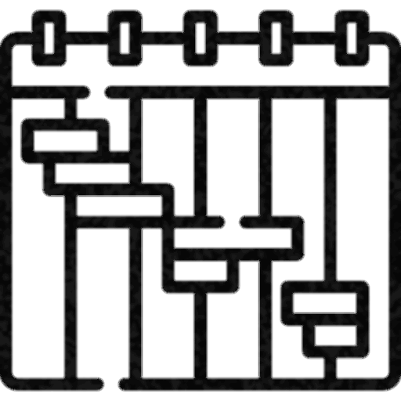

Time plan
Week (01-02)
Determine platform requirements and initial research
Week (03-04)
Prepare the initial platform plan and begin detailed research
Week (05-06)
Platform Design (UI/UX)
Week (07-08)
Start software development for the platform
Week (09-10)
Continue software development and start unit testing

Slide 22
Week (01-02)
Determine platform requirements and initial research
Week (03-04)
Prepare the initial platform plan and begin detailed research
Time plans
Week (05-06)
Platform Design (UI/UX)
Week (07-08)
Start software development for the platform
Week (09-10)
Continue software development and start unit testing
Week (11-12)
Complete software development and complete unit testing

Slide 23
Week (05-06)
Platform Design (UI/UX)
Week (07-08)
Start software development for the platform
Week (09-10)
Continue software development and start unit testing
Time plans
Week (11-12)
Complete software development and complete unit testing

Slide 24

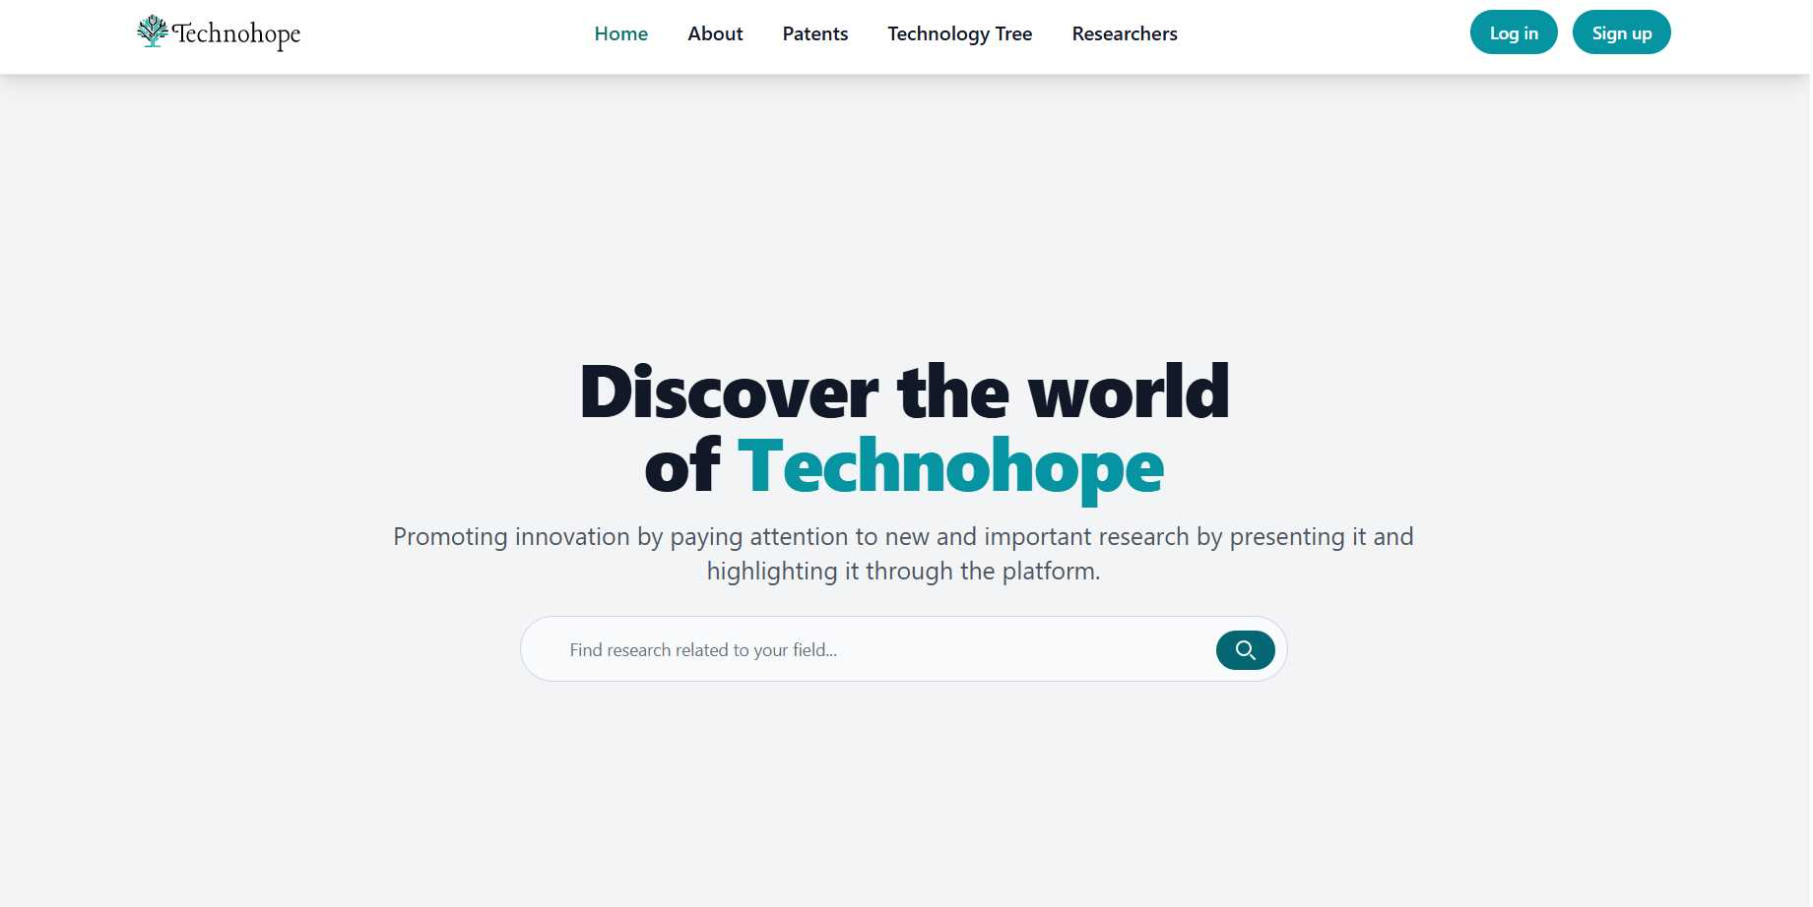

Platform Design
Platform Design
95%
Current station
project completed
Complete software development and complete unit testing
Current progress
We are doing our best to complete the project as completely and as quickly as possible.

Slide 25
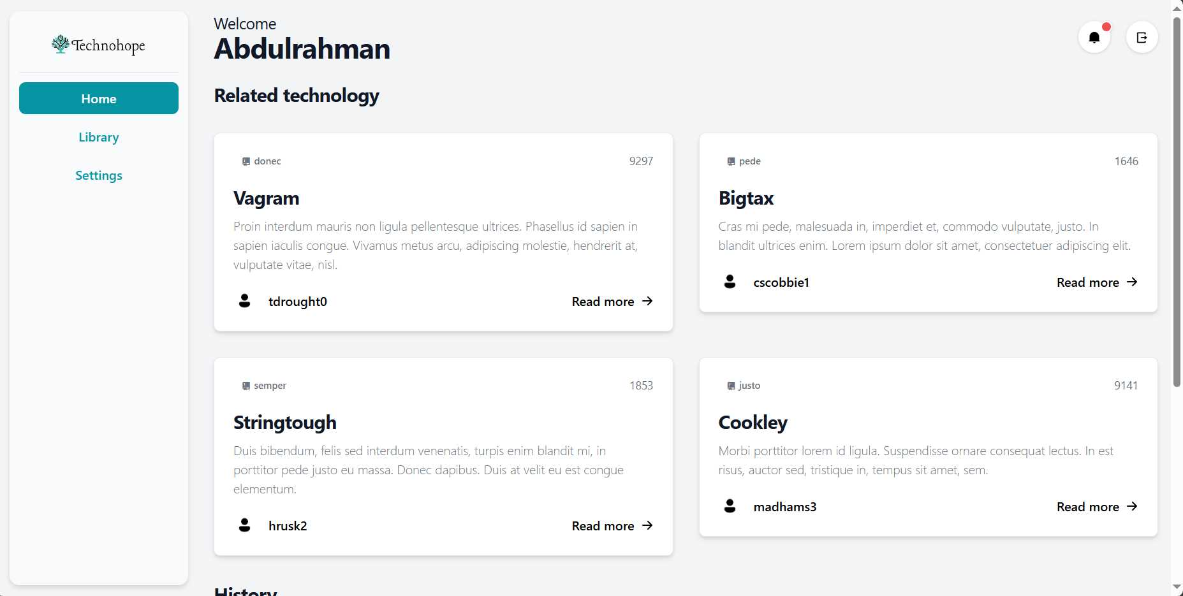
Dashboard: Home
Platform Design

Slide 26
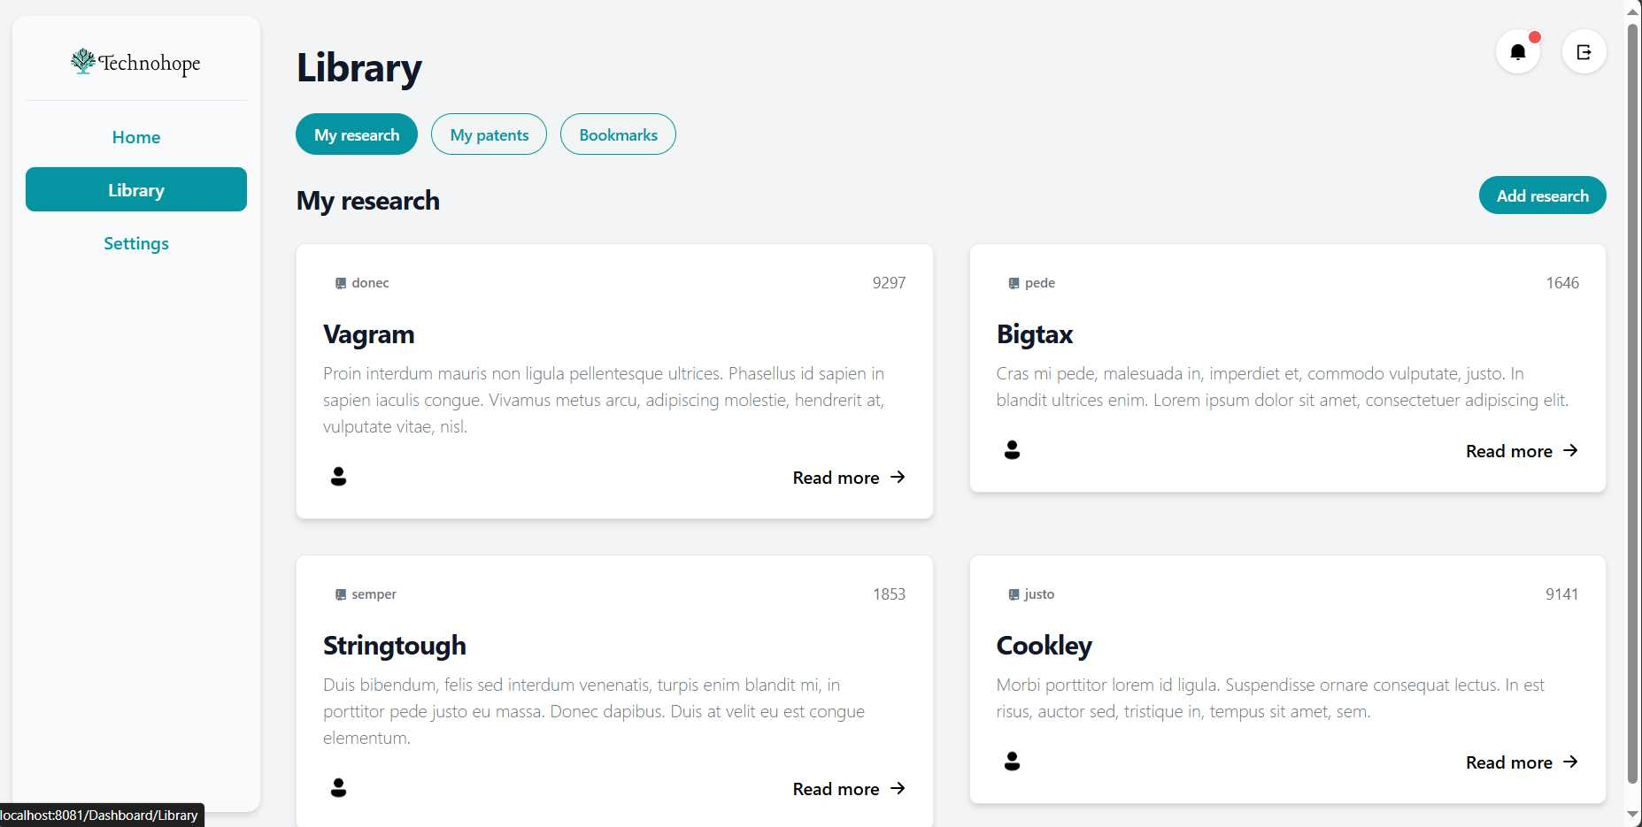
Dashboard: Library
Platform Design

Slide 27
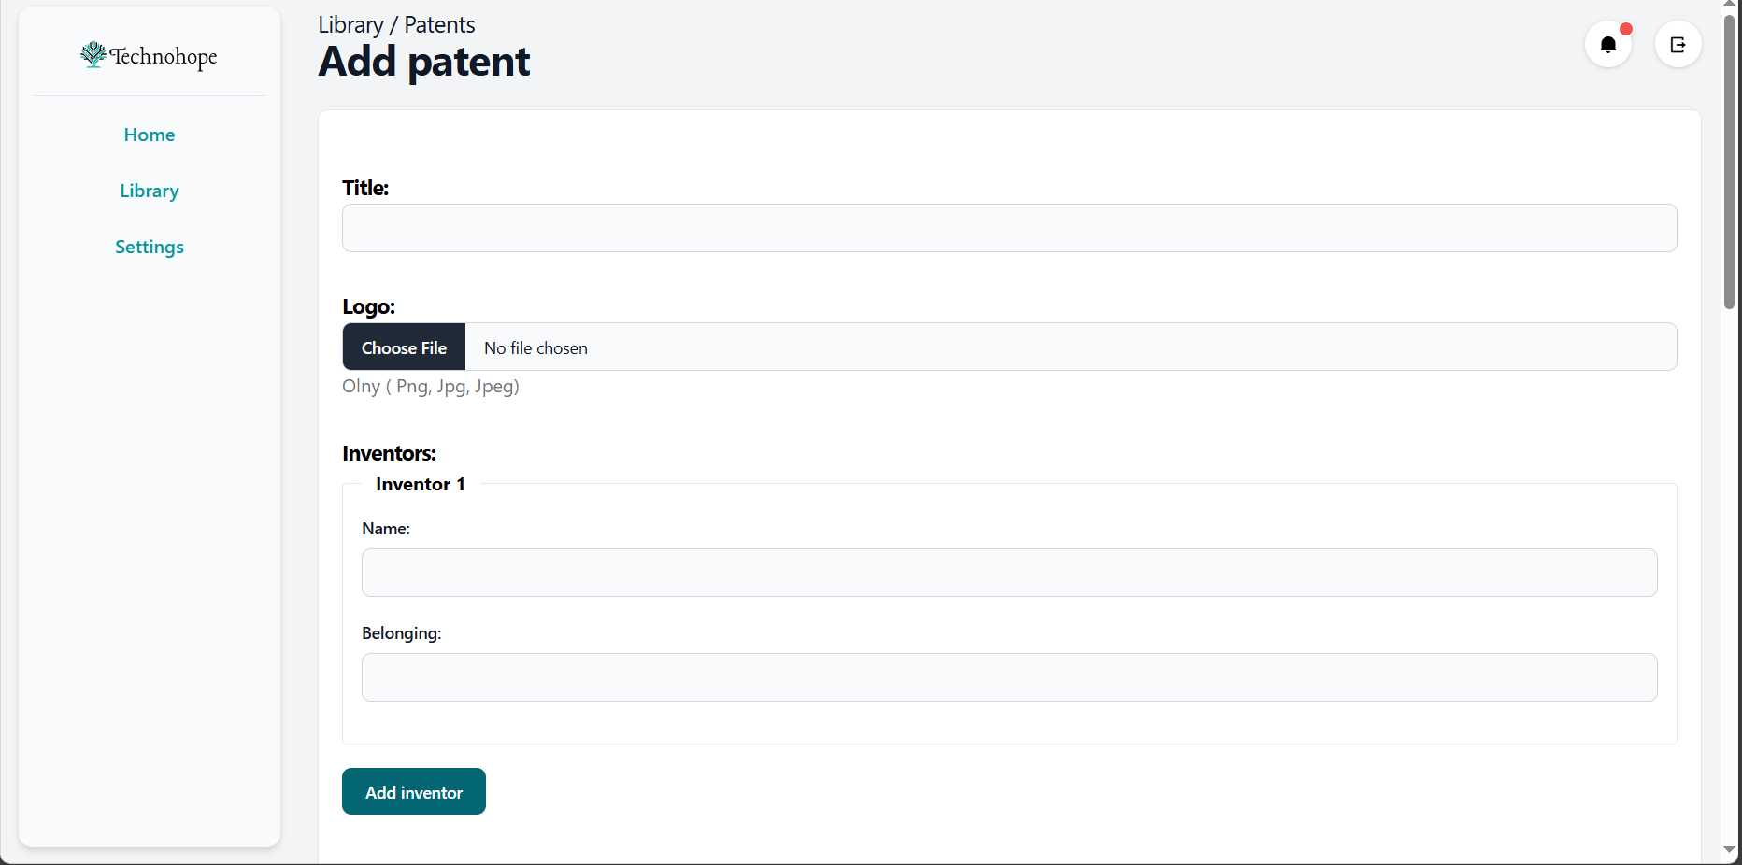
Dashboard: Upload Page
Platform Design

Slide 28
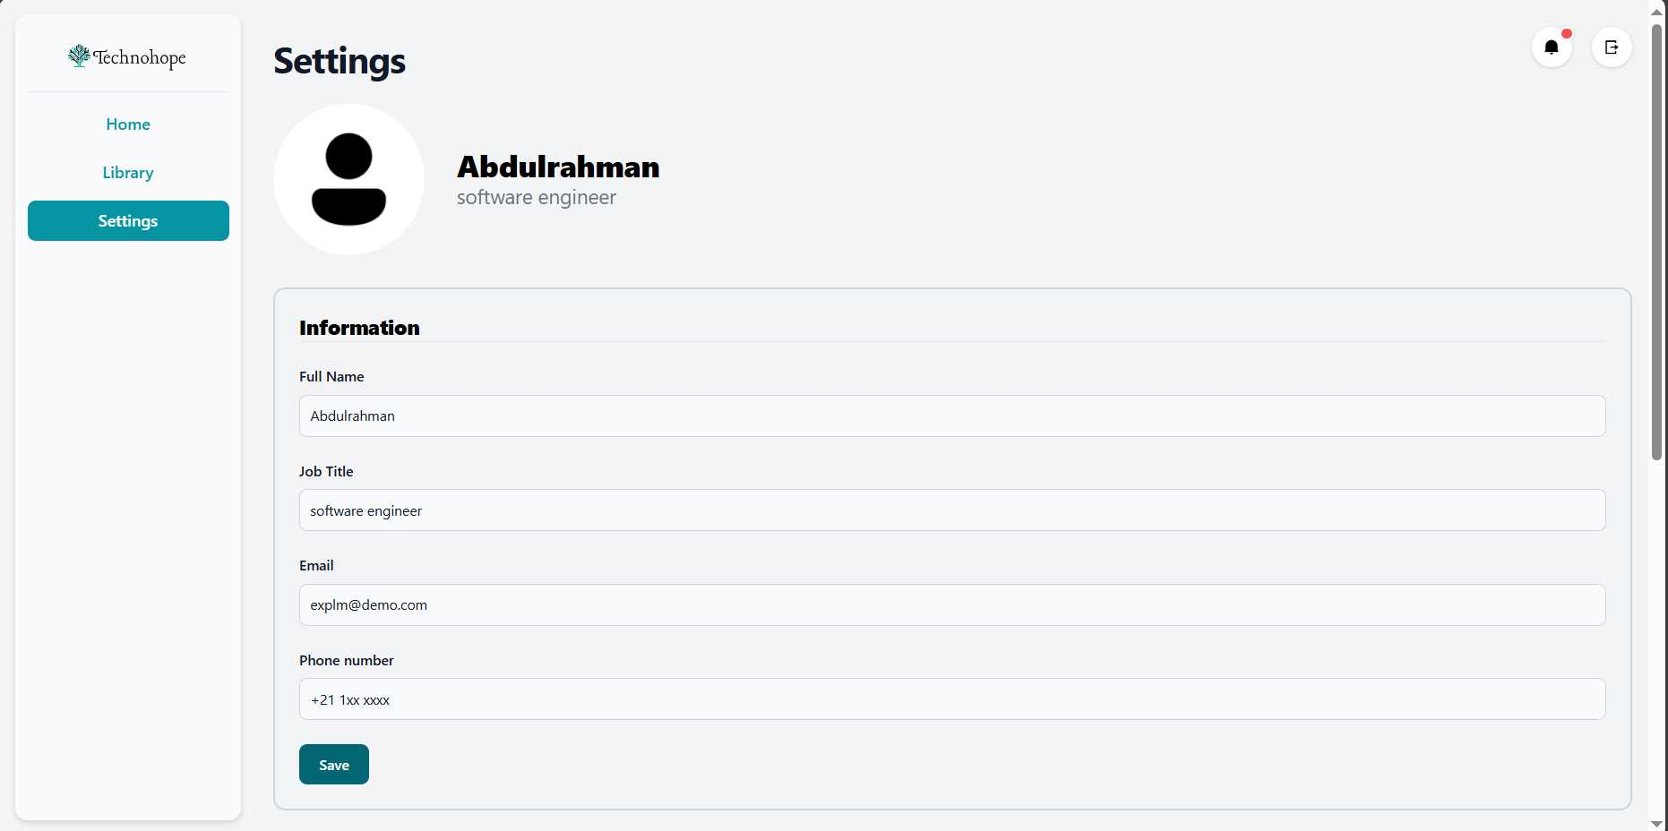
Dashboard: Settings
Platform Design

Slide 29

Site Tour
Platform Design

Slide 30

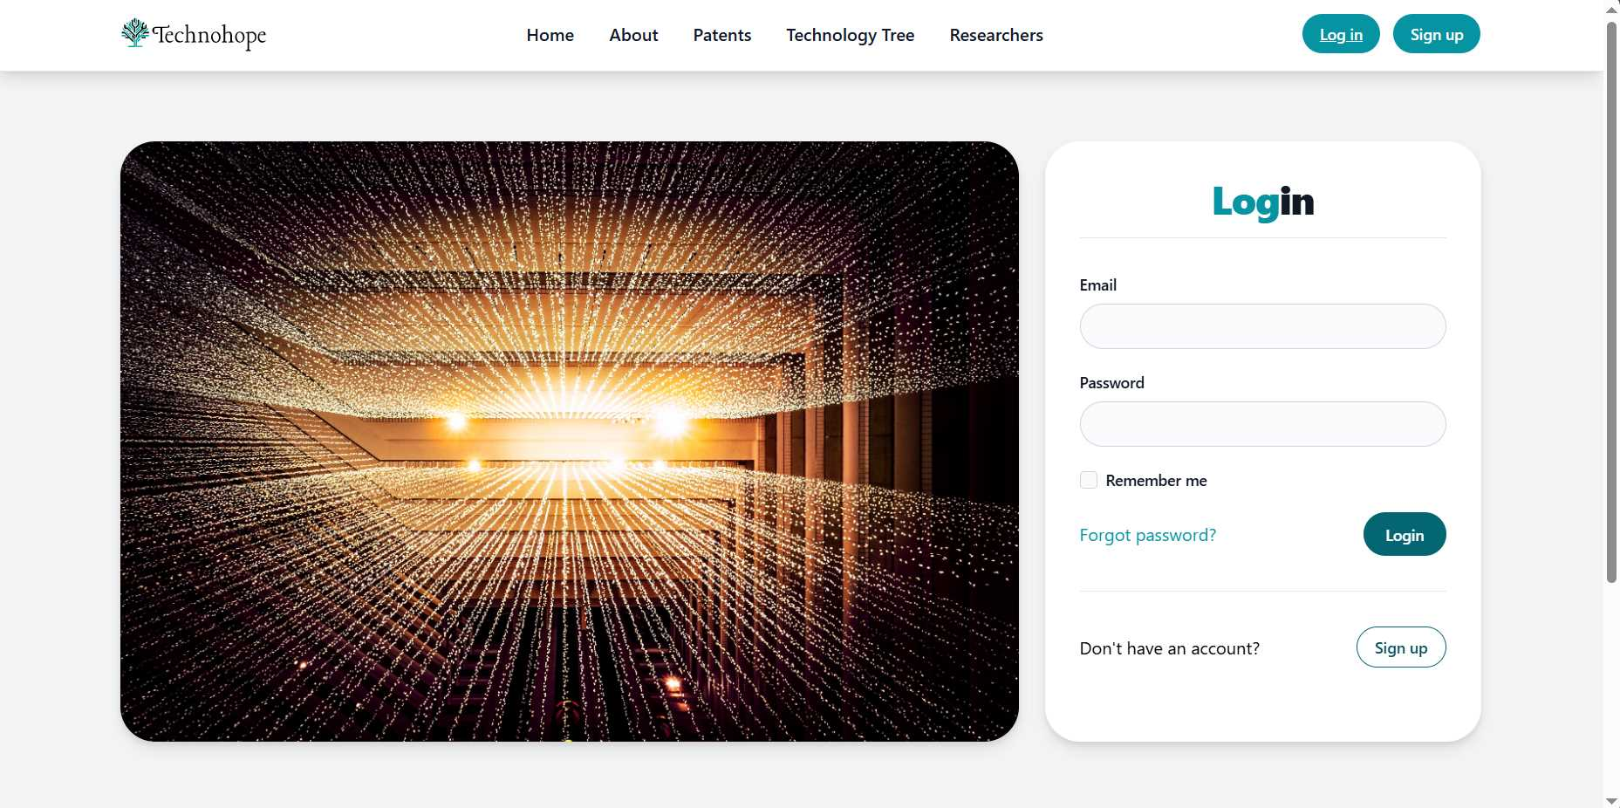
Site Tour
Platform Design

Slide 31
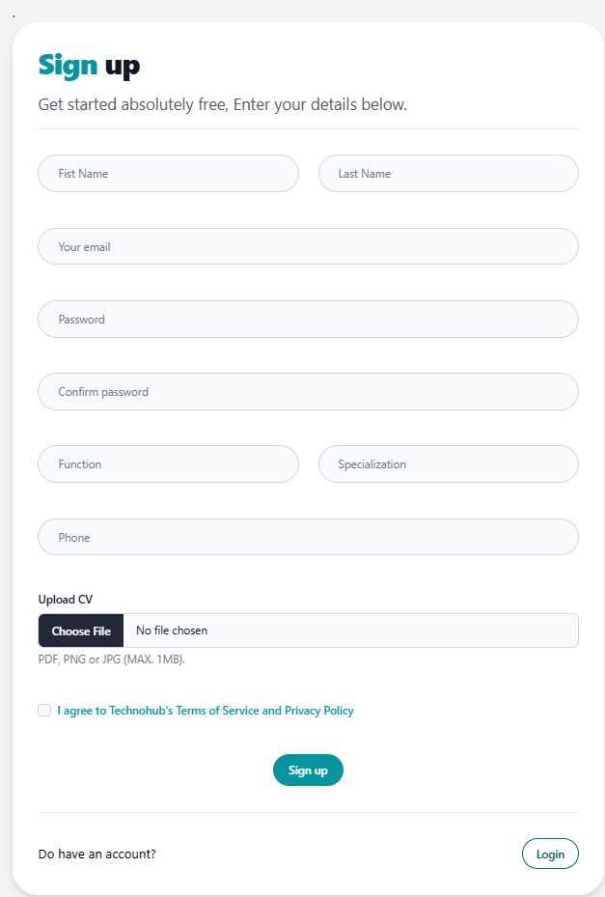
Site Tour
Platform Design

Slide 32
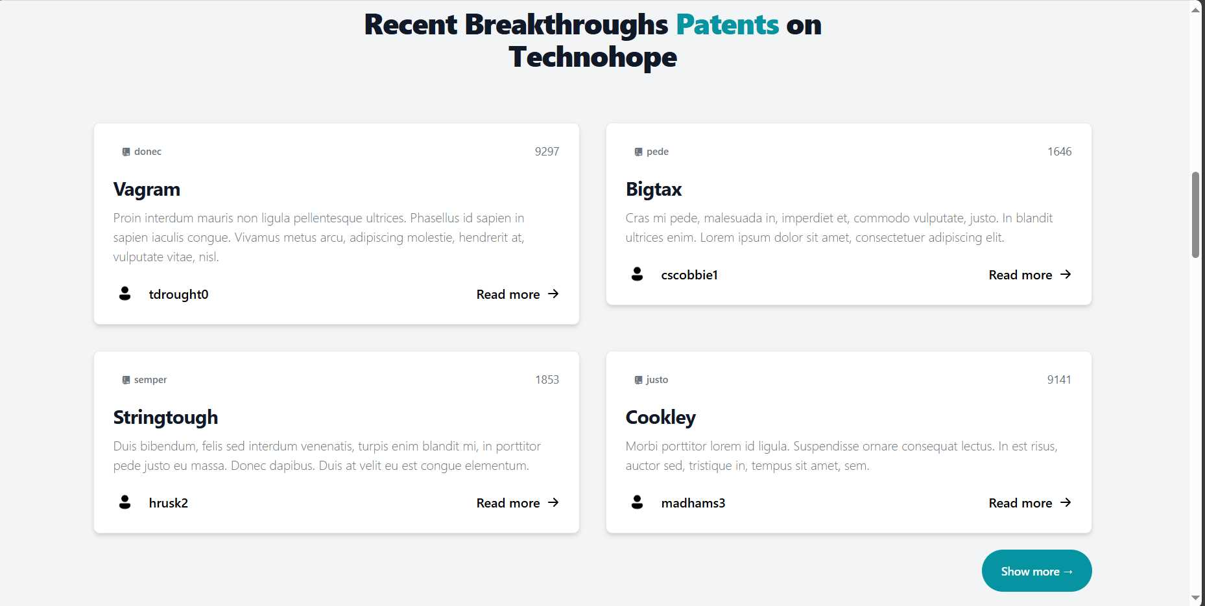
Site Tour
Platform Design

Slide 33
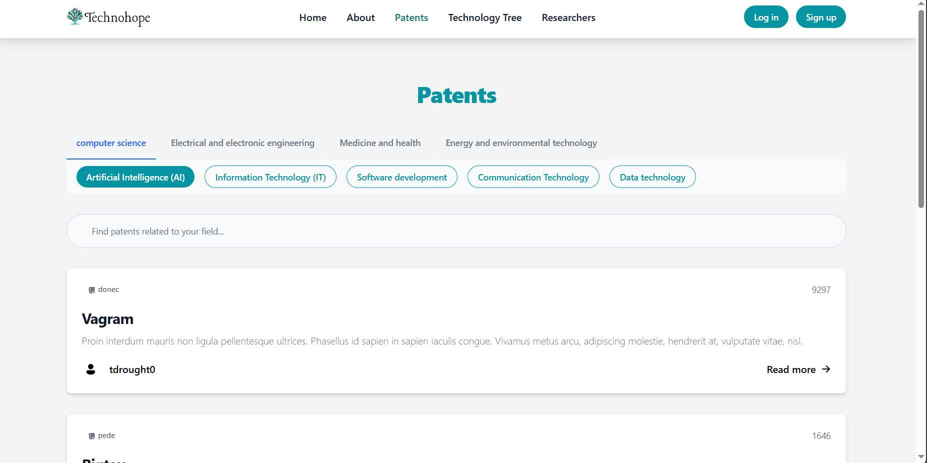
Site Tour
Platform Design

Slide 34
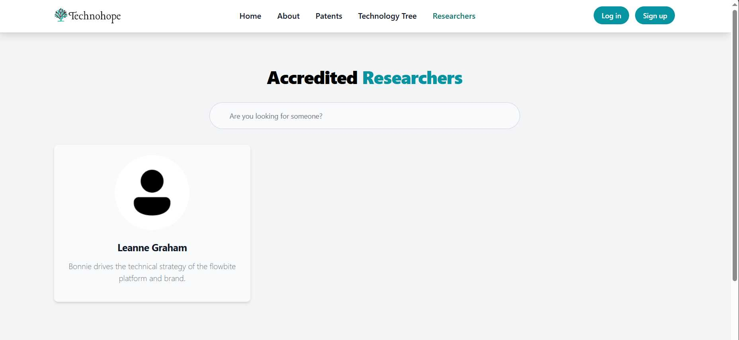
Site Tour
Platform Design

Slide 35
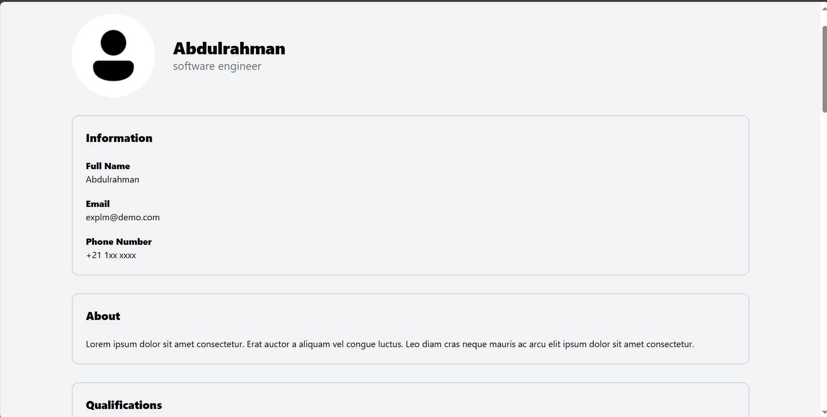
Site Tour
Platform Design

Slide 36
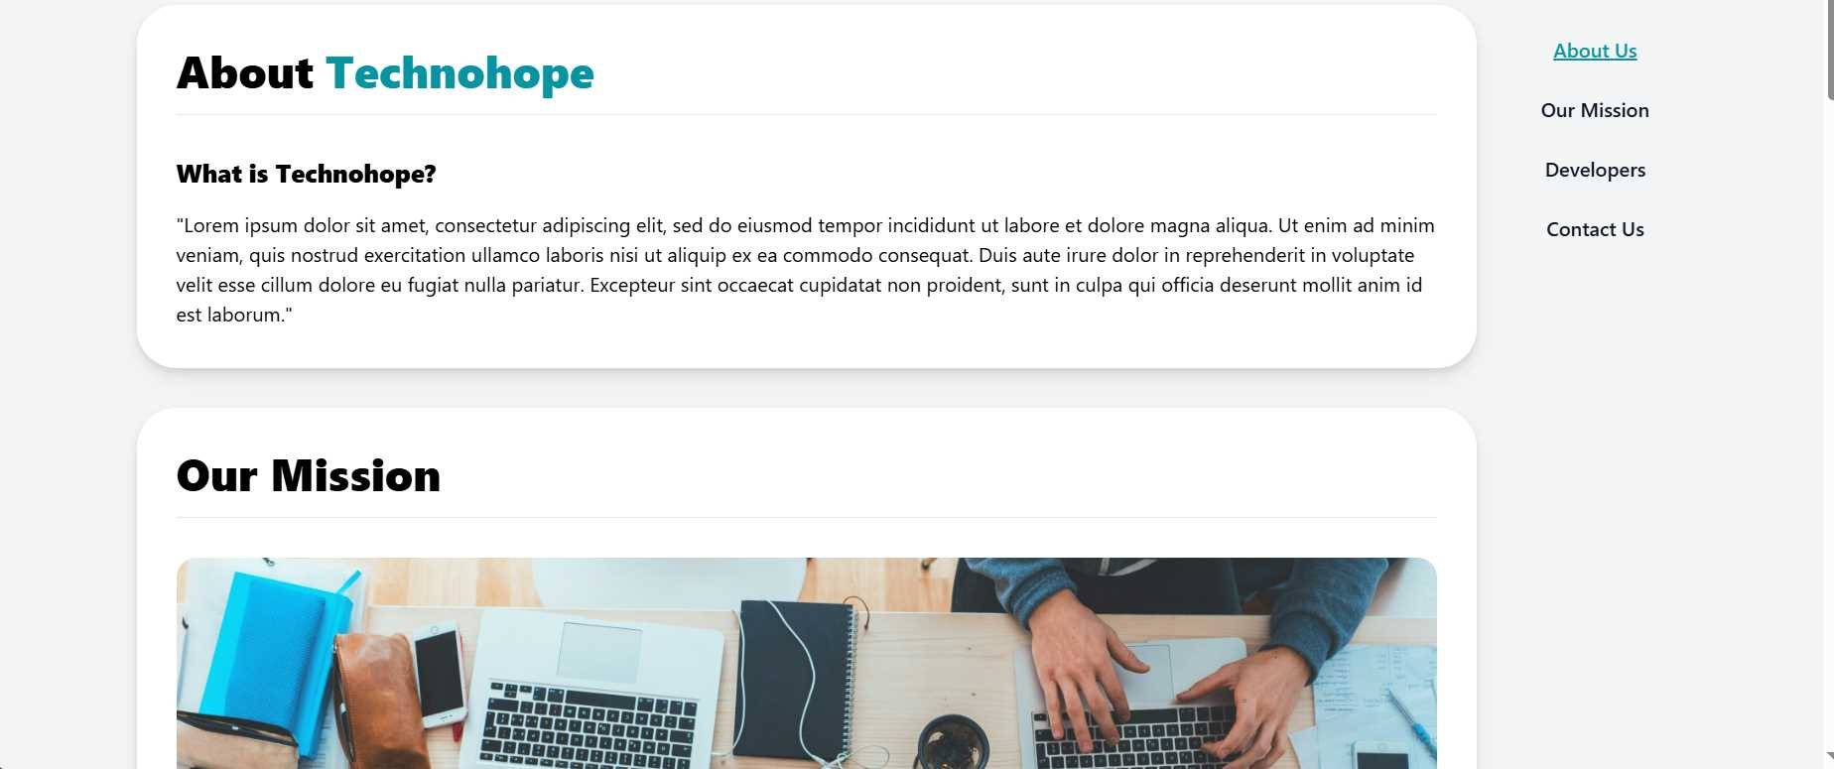
Site Tour
Platform Design

Slide 37
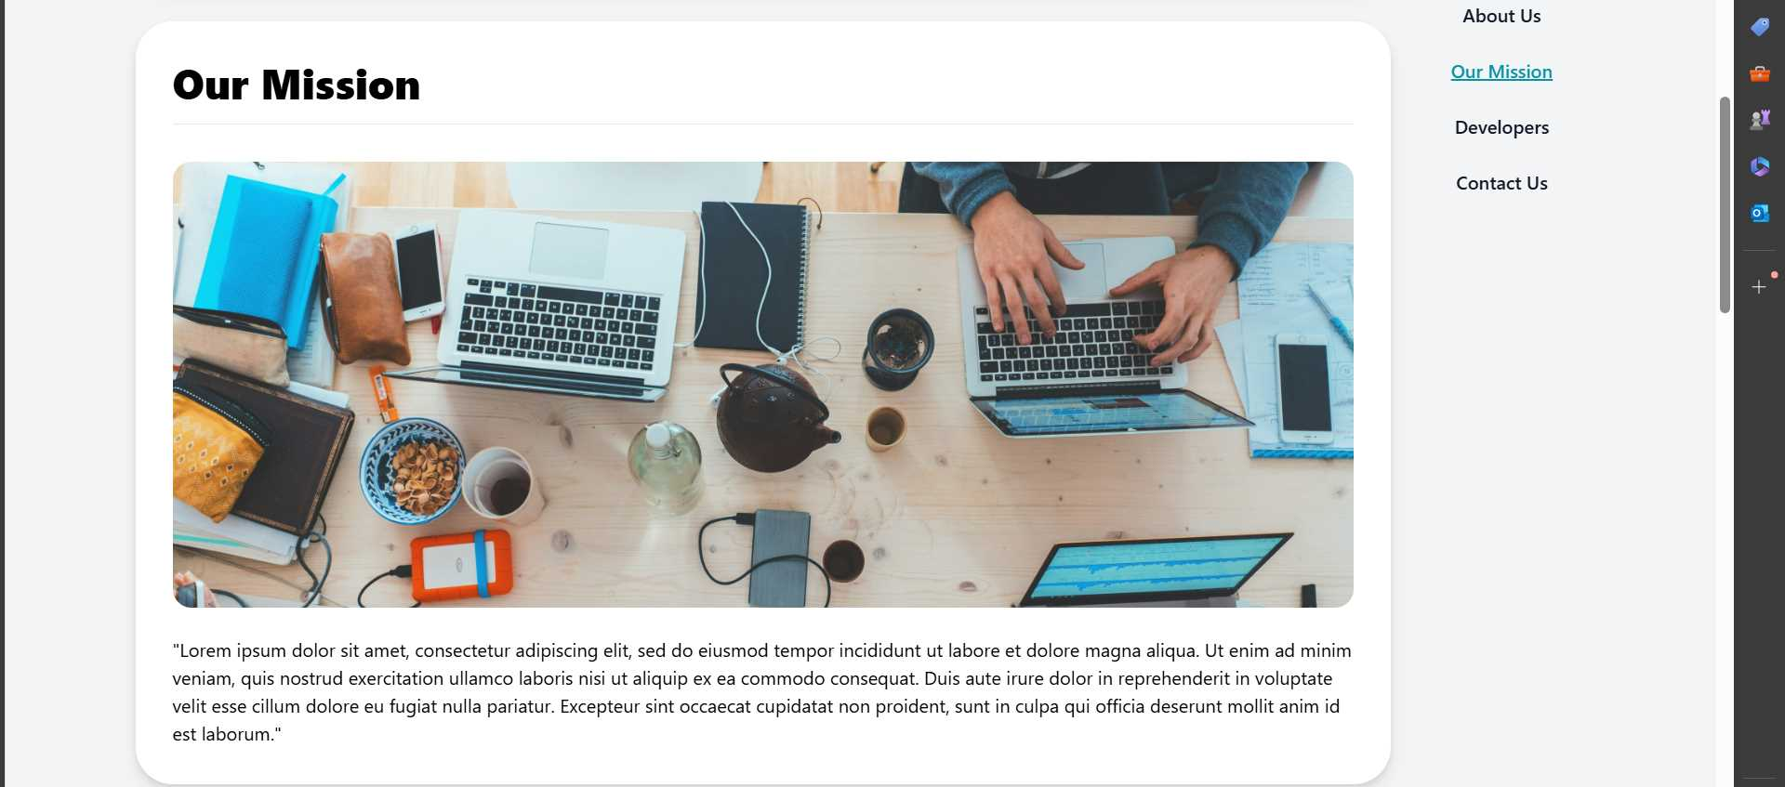
Site Tour
Platform Design

Slide 38
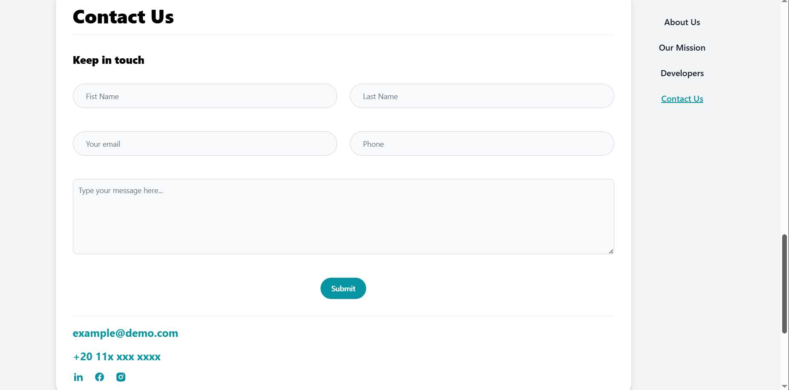
Site Tour
Platform Design

Slide 39


Site Tour
Platform Design

Slide 40


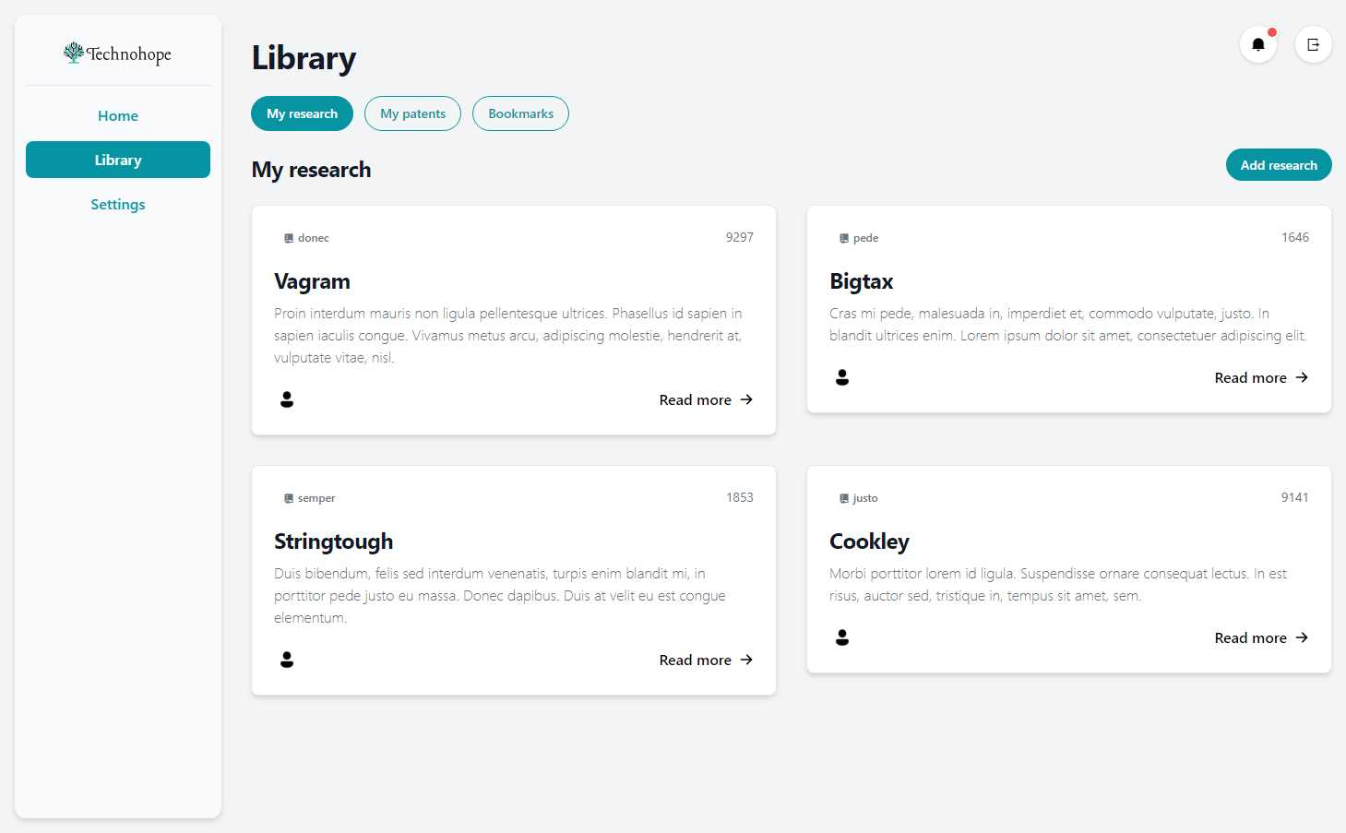

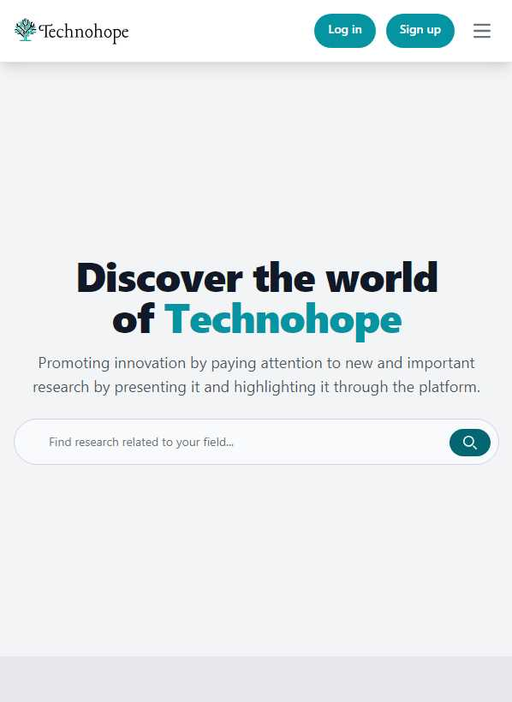

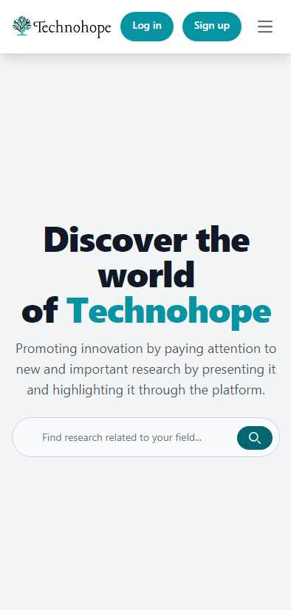
Compatible with all devices

Slide 41
Project Challenges
We sure had our fair share of “problems”, “setbacks”, “I want to quit moments”, “I have no idea what I'm doing moments”, and so on…
However, we did our best overcome those challenges (somehow) and we managed to build the platform. YAY!
The challenges we faced during the platform development
Technical Challenges:
Choosing the Right Tech Stack: Selecting appropriate programming languages, frameworks, and libraries for building the platform's functionalities. This can be overwhelming with so many options available.
Learning Curve: Not all members of the teams were familiar with all the tools we used in the project, this took additional time to learn how to use them.
Limited Resources: We had limited access to development tools and skills compared to professional teams.
Project Management: Keeping the project organized, managing deadlines, and ensuring all aspects of development (front-end, back-end, database) are addressed effectively.
Non-Technical Challenges:
Time Management: Balancing schoolwork with the demands of project development, that wasn’t fun.
Communication and Collaboration: Effectively communicating within the development team and delegating tasks efficiently.
Testing and Debugging: Identifying and fixing errors and bugs in the code. This can be a frustrating (it was) but crucial step in building a robust platform.
Scope Creep: Managing the project scope and avoiding the temptation to add too many features, which could extend development time and resources.

Slide 42

Conclusion
In conclusion, we have presented Technohope, a platform that connects researchers, innovators, entrepreneurs, and investors who are interested in transforming scientific and technological outcomes into new products and services that benefit society.
We have explained the concept and importance of technology transfer, the features and benefits of Technohope, the process and examples of technology transfer projects facilitated by Technohope, and the steps to join and use Technohope.
We have also described the objectives, requirements, and tools of our platform.
And we went through the challenges we bravely overcome during the development of the platform.
We hope that Technohope will contribute to the advancement of science and innovation, and to the creation and diffusion of new technologies that can solve global challenges and improve the quality of life of people.

Slide 43

Future work
● Technohope facilitates the communication and negotiation between the parties and provides tools and templates for drafting and signing agreements, such as non-disclosure agreements, licensing agreements or collaboration agreements.
● Innovation support:
o Promoting innovation by paying attention to new and important research by presenting it and highlighting it through the platform.
● User evaluation and reporting:
o Establish an evaluation for the user and prepare a method to evaluate them in terms of participation.
● Customizable user profiles:
o Allow users to create detailed profiles showcasing their expertise, interests and technology.
● Technology and patent browsing and searching:
o The entrepreneurs and investors should be able to browse and search the technologies and patents that are available for licensing or collaboration, by keywords, categories, or filters.
● Technology and patent contacting and negotiating:
o The entrepreneurs and investors should be able to contact the owners of the technologies and patents that they are interested in and to negotiate the terms and conditions of the technology transfer agreements, such as non-disclosure agreements, licensing agreements, or collaboration agreements.
● Security:
o The platform should be secure and protect the data and privacy of the users and should provide encryption, authentication and authorization mechanisms.

Slide 44




Thank You!

